Slide 1
Plant Data Analysis
Insights from Pivot Tables and Visualizations

Slide 2
INTRODUCTION
Content: This project analyzes a plant dataset using Excel for data analysis and visualization. Key attributes examined include leaf color, height, plant type, flowering season, and water requirements. Through pivot tables and charts, we explore insights such as counting plants by flowering season, analyzing water needs, and categorizing plants by leaf color.

Slide 3
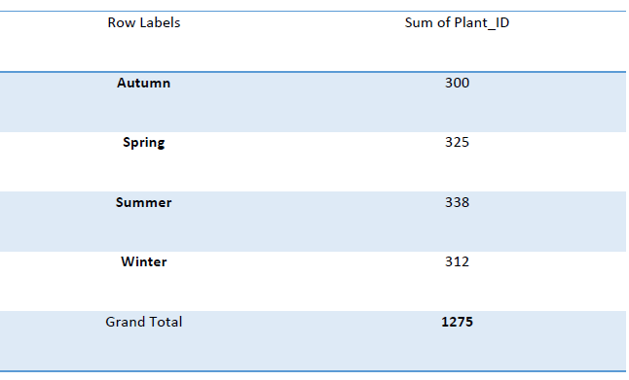
The table shows the total Plant_IDs for each season: Autumn (300), Spring (325), Summer (338), and Winter (312). The Grand Total across all seasons is 1,275.

Slide 4
The bar chart displays the average water requirement (L/week) for different plant types. The Creeper has the highest average at 3.14 L/week, followed by the Climber at 3.05 L/week and the Tree at 3.00 L/week. The Shrub and Herb require less water, averaging 2.95 L/week and 2.86 L/week, respectively.

Slide 5
The bar chart displays the total number of plants categorized by leaf color. Variegated leaves have the highest total, with around 260 plants. This is followed by Yellow leaves, totaling approximately 220 plants, and Red leaves at about 240 plants. The Purple category shows a similar count to Red, while Green has the lowest total, with around 210 plants. Overall, the chart highlights the distribution of plant colors within the dataset, with Variegated being the most common.

Slide 6
CONCLUSION
This analysis highlights key findings about our plant data:
Seasonal Distribution: A total of 1,275 Plant_IDs were recorded across seasons.
Water Needs: Creepers require the most water at 3.14 L/week, while Herbs need the least at 2.86 L/week.
Leaf Color: Variegated plants dominate the dataset with 260 plants, while Green plants are the least at 210

